Slide 1
Microsoft Teams Students Account Activation
The following document show the steps of how to navigate through the activation of your student MS 365 account for easy access to online lessons on TEAMS
Mwansa Chilekwa

Slide 2
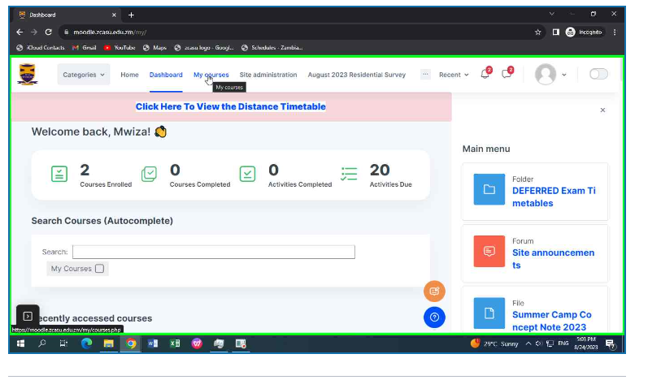
Step 1 - Log in into your Moodle and click on my courses tab in the navigation bar as shown below.

Slide 3
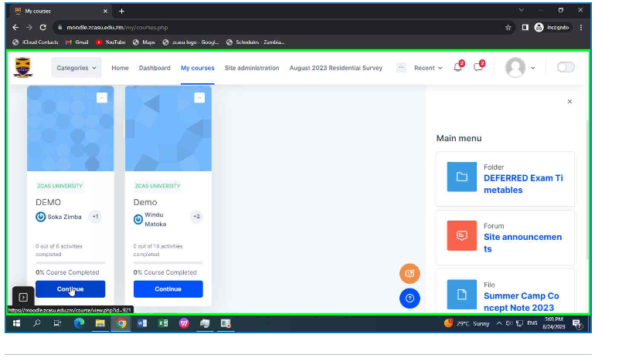
Step 2 – Navigate to the courses that you need to join the class, as shown below

Slide 4
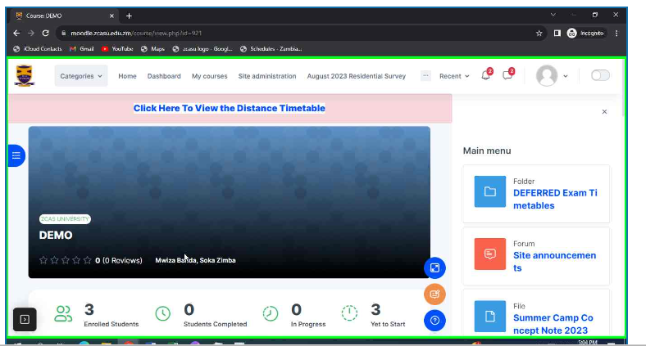
Step 3 – After navigating to the desired course, you will be directed to the page similar to the page shown below, showing your course name and other valid information for that course as shown below.

Slide 5
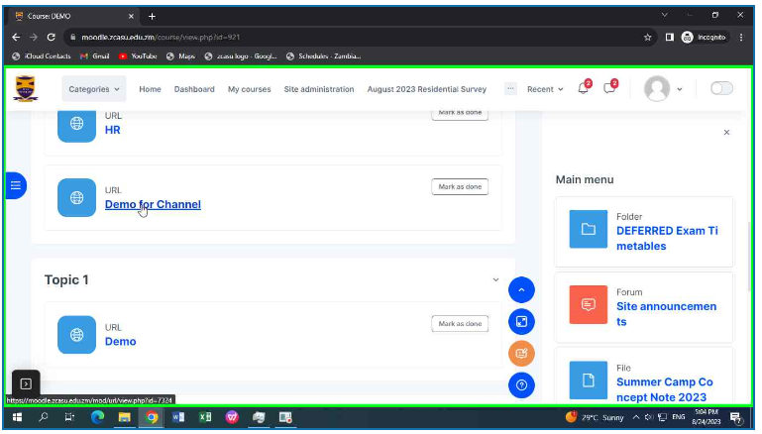
Step 4 – In the specific course you have opened, navigate to links that are available for that course, these may be links to resources like online classes, and other links to other valid information that are provided to you by your lecturers.

Slide 6
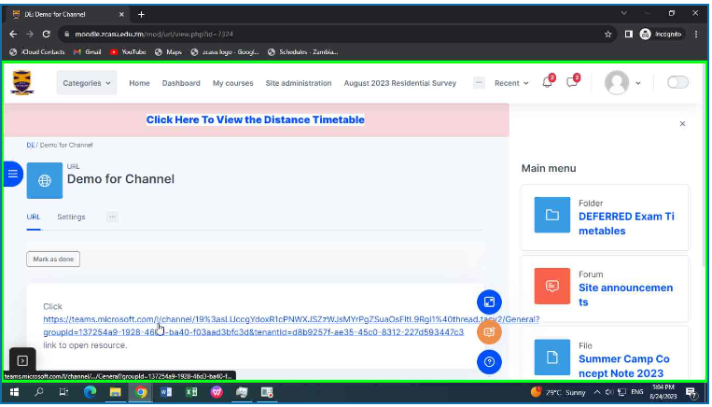
Step 5 – After clicking that specific URL, you will be directed to the actual link that will direct you the resource that you are intended to access. In our example it’s a link to a Microsoft Teams Meeting

Slide 7
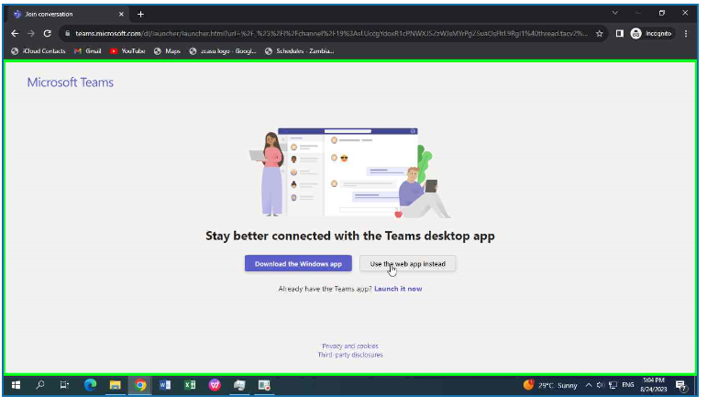
Step 6 – After clicking the specified link it directs to a resources that is intended to be accessed, as seen in our example we have been directed to the Microsoft teams page, and options to choose either to download the app on our machine or just use the app within browser.

Slide 8
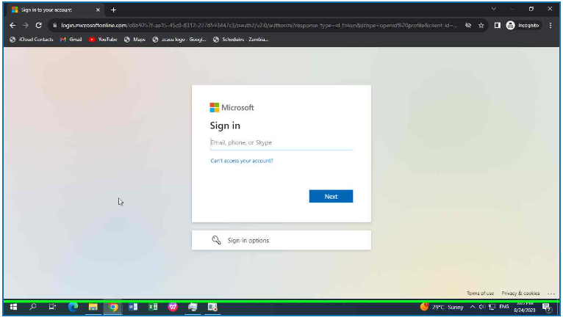
Step 7 – The next stage you will be prompted to log into your Microsoft 365 account, this accounts is in the format studentNumber@zcasu.edu.zm for all fully registered students

Slide 9
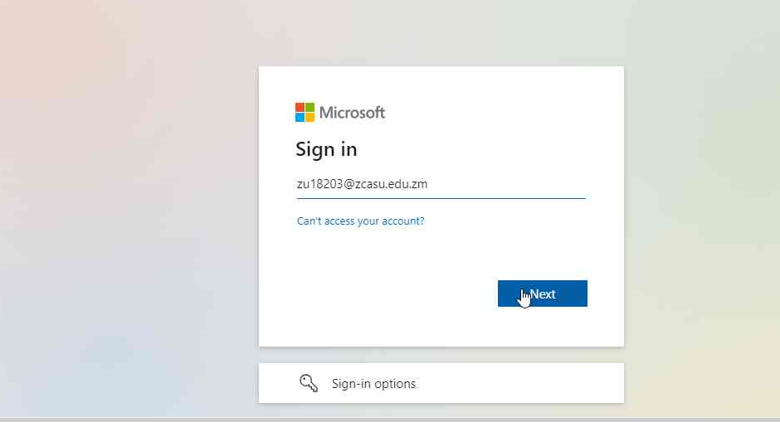
Step 8 – The account username will look like the one shown below.

Slide 10
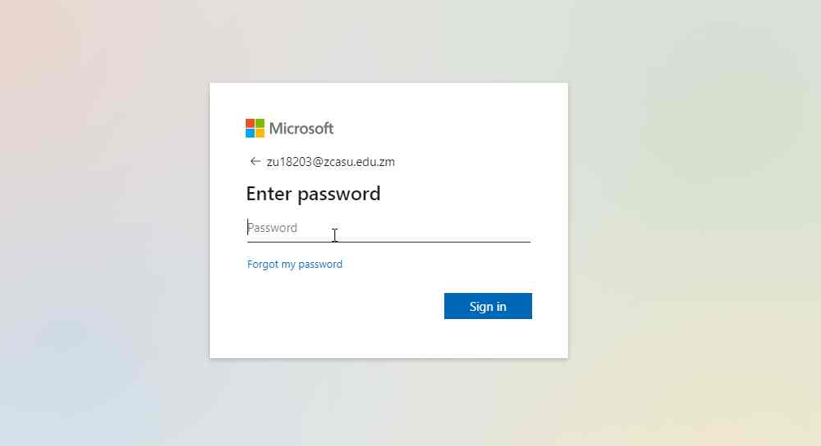
Step 9 – The next stage will prompt you for a password, for first time user, user a default password ZCASU.12345

Slide 11
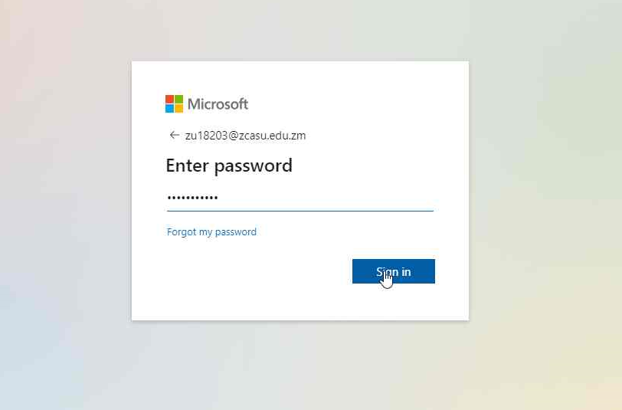
Step 10 – Click next to proceed

Slide 12
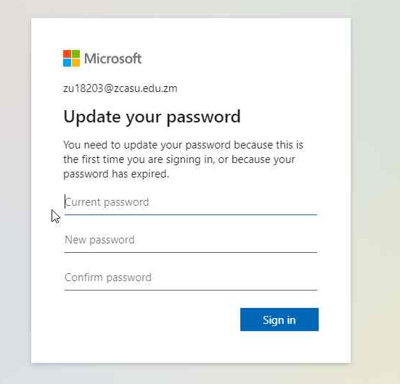
Step 1- Update the password for first time log in
-Enter current password: ZCASU.12345
And enter a new password

Slide 13
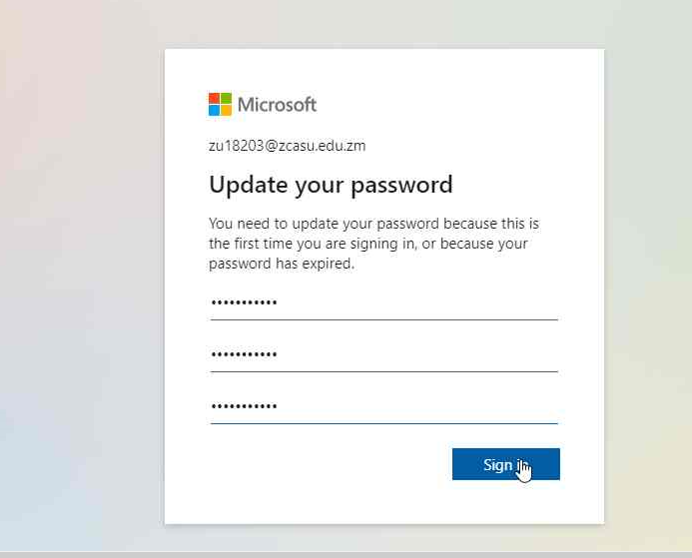
Step 12- Click sign in

Slide 14
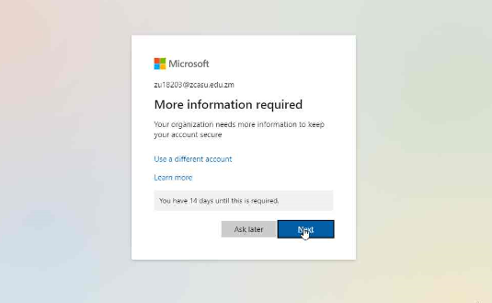
Step 13- Click Next

Slide 15
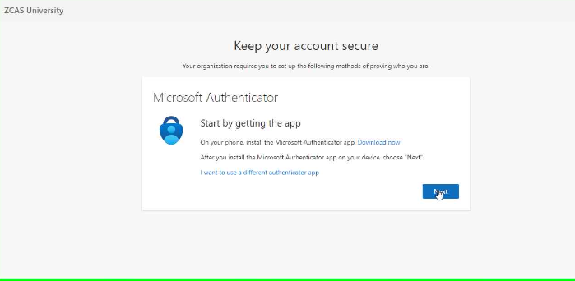
Step 14- Download Microsoft Authenticator app on your phone
-Open the app and click on Next

Slide 16
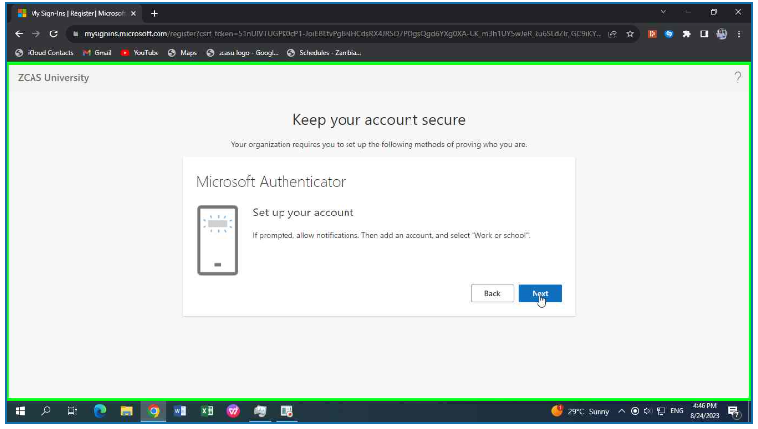
Step 15- On your phone click Add work or School account and select Scan QR code and click Next as shown below
:
:
:
:
:
:
:

Slide 17
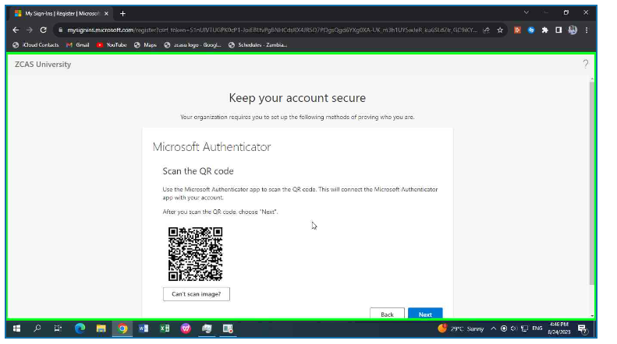
Step 16- Scan the QR code using your phone and click Next

Slide 18
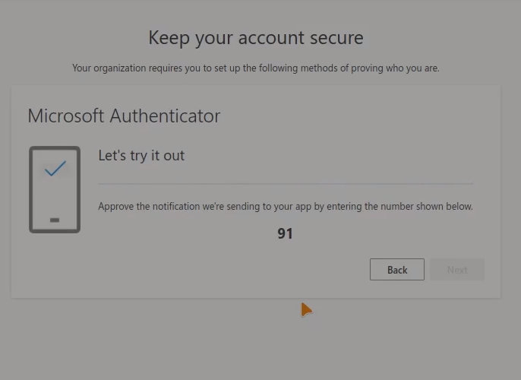
Step 16.1 – Enter the number that appears on the screen onto your Microsoft Authenticator app prompt
.

Slide 19
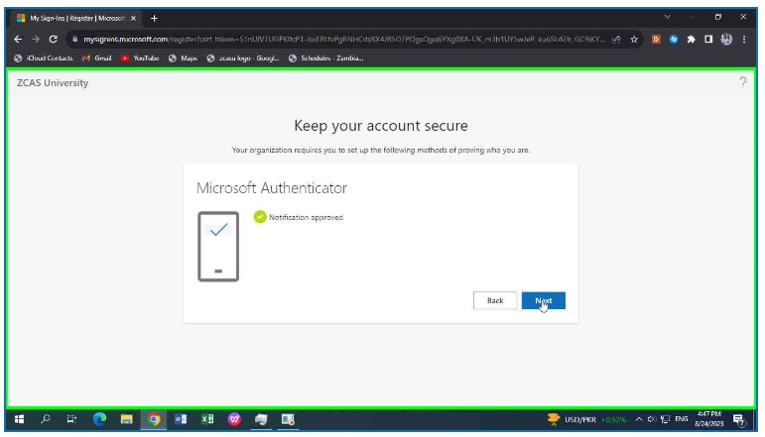
Step 17- When authenticated click Next

Slide 20
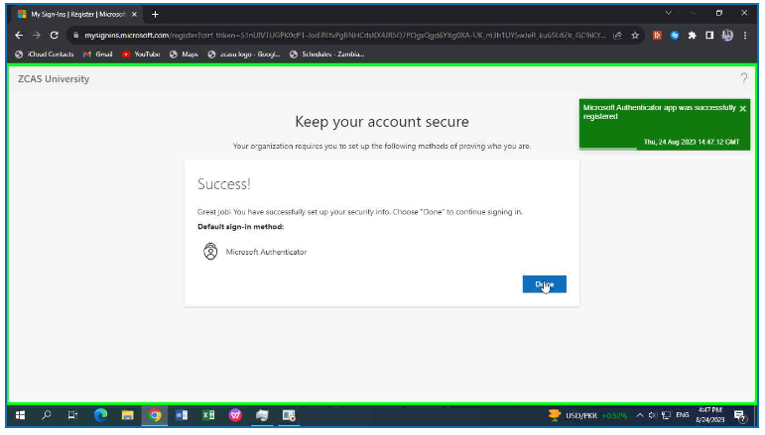
Step 18- Click Done

Slide 21
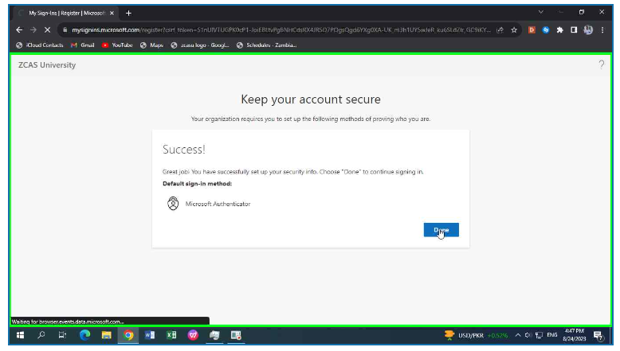
Step 19 -Click Done again

Slide 22
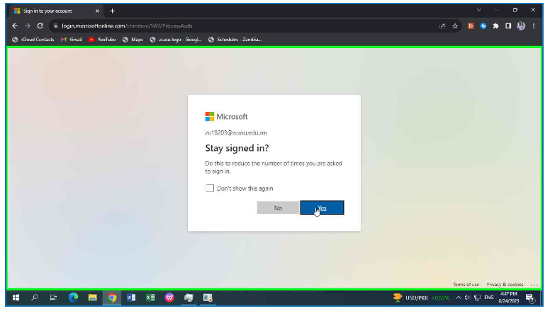
Step 20-Click Yes

Slide 23
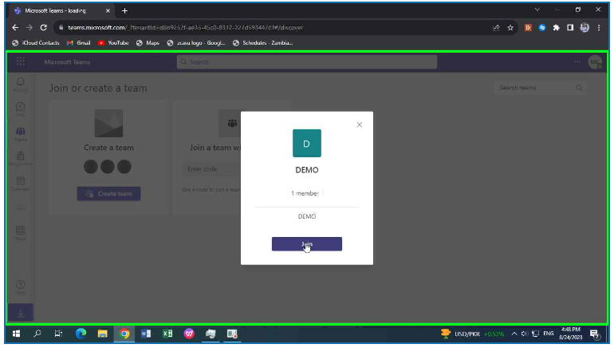
Step 21- On the next interface click on Join

Slide 24
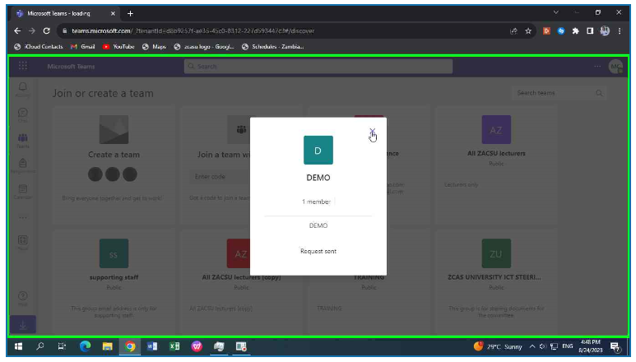
Step 22- Click on Close and wait for the request approval from your lecturer

Slide 25
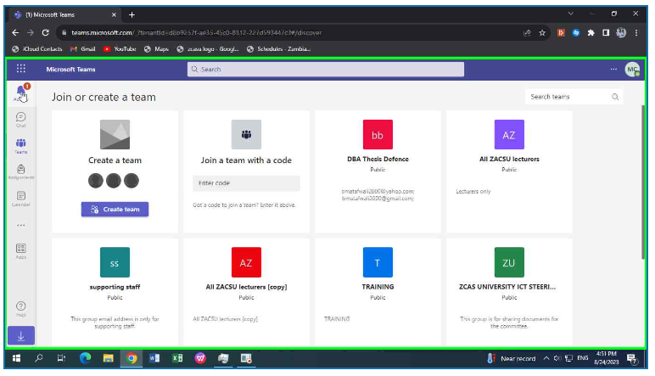
Step 23- When approved you will receive a notification
-Click on Notification in top left corner

Slide 26
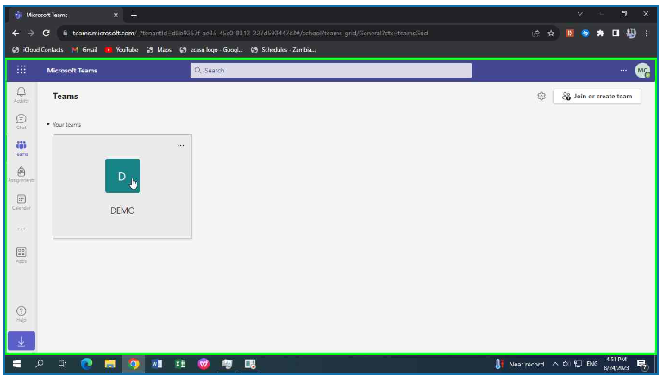
Step 24 – click on the name of the team class

Slide 27
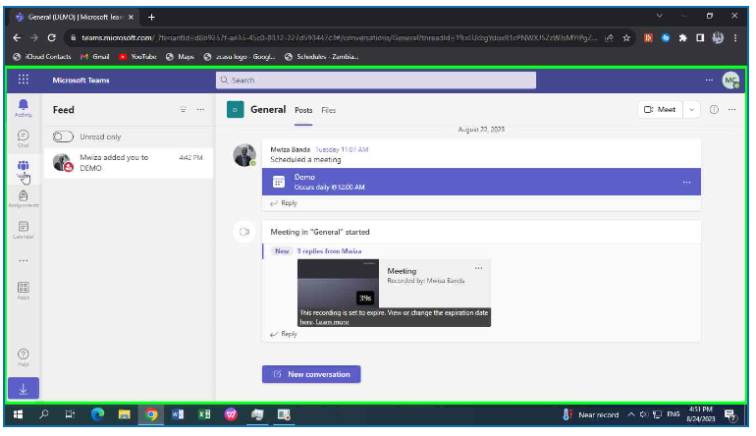
Step 25- Click on scheduled class by your lecturer

Slide 28
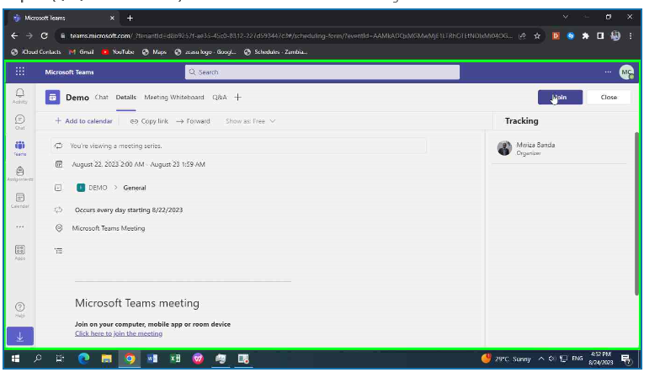
Step 26- In top left corner click Join

Slide 29
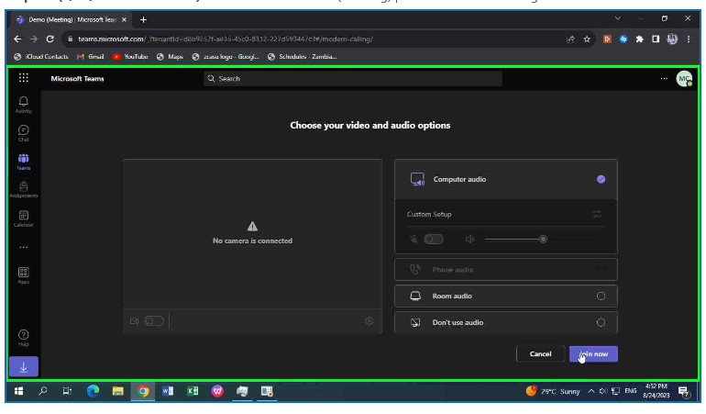
Step 27- Finally click join now to join class

Slide 30
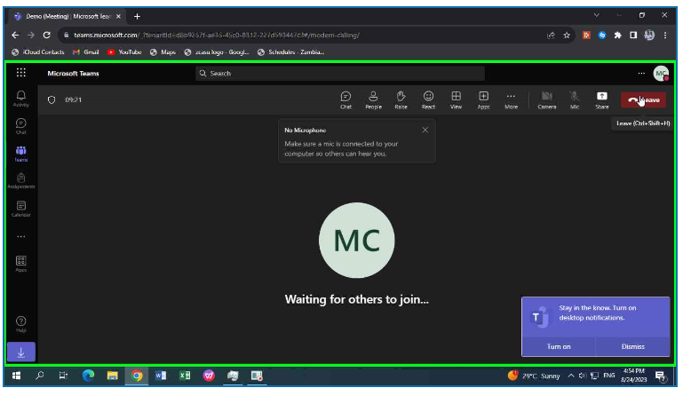
Step 28- You have successfully joined the class

